Slide 1
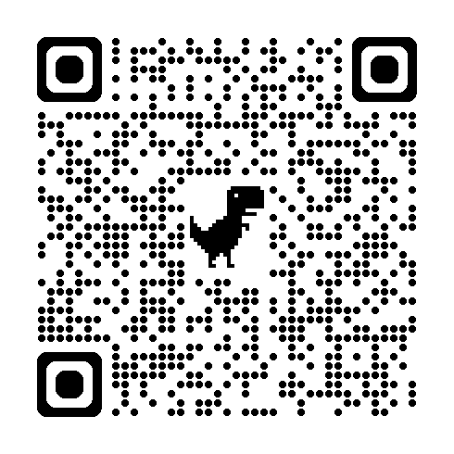
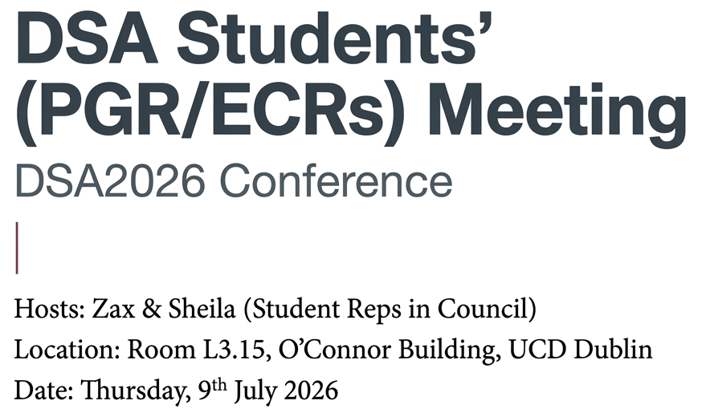

Scan the QR Code to register

Slide 2
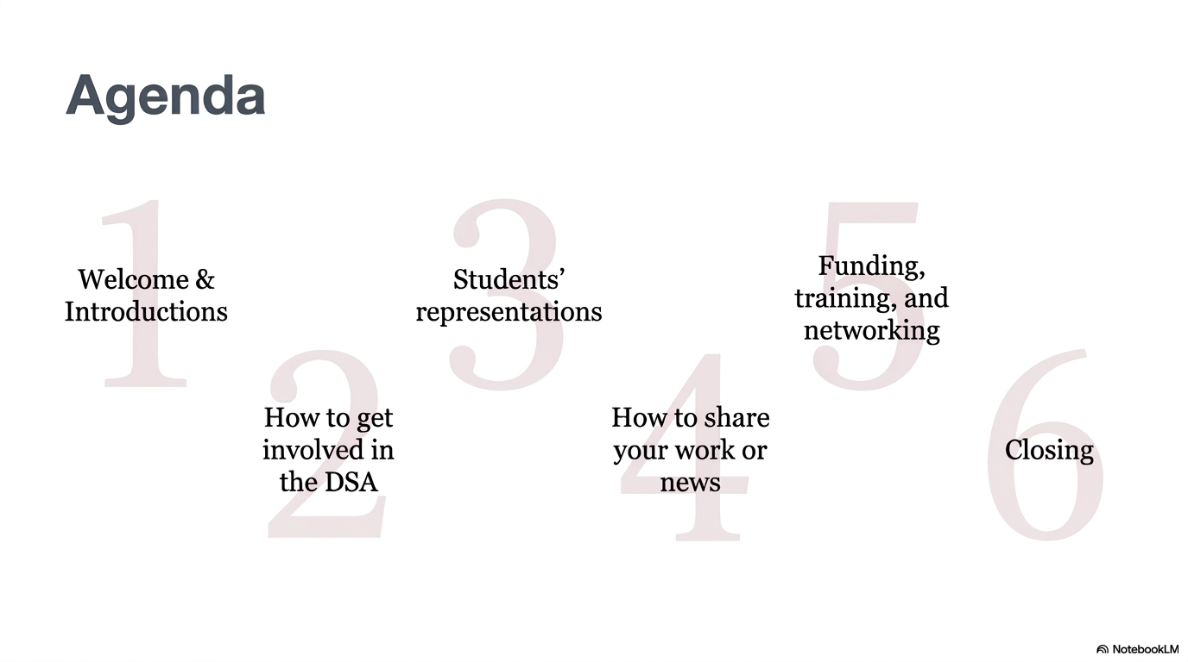
Scan the QR Code to register

Slide 3


Slide 4

Scan the QR Code to register
Welcome/Introductions

Slide 5
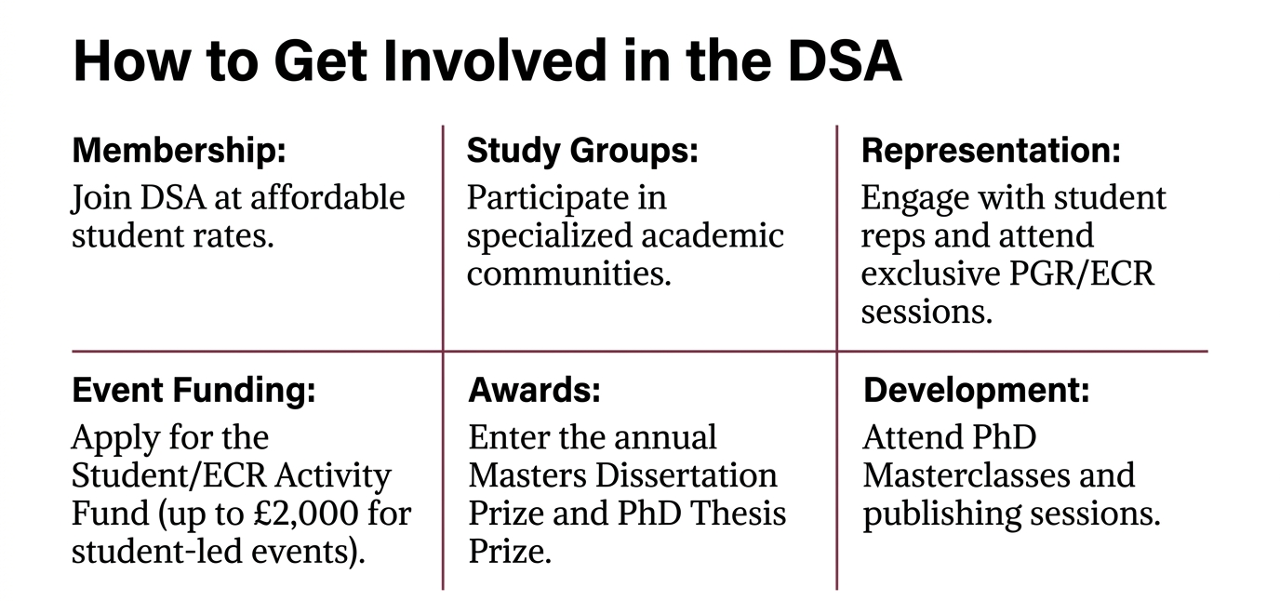
https://www.devstud.org.uk/what-we-do/students-and-ecrs/
Scan the QR Code to register

Slide 6

Scan the QR Code to register
STUDENTS’ REP
https://www.devstud.org.uk/what-we-do/our-members/

Slide 7


Scan the QR Code to register

Slide 8
STUDENT EVENTS
Scan the QR Code to register
‘Shut up & Write’ Sessions by Jenni Argent (University of Edinburgh)
Academic Blogging Webinar
PGR/ECR Grant Training Workshop
Writing Journal Articles by Chidinma Mbaegbu (Leicester University)
Study Group event for Global South Researchers (Challenges)

Slide 9
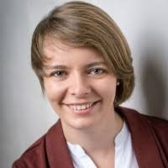
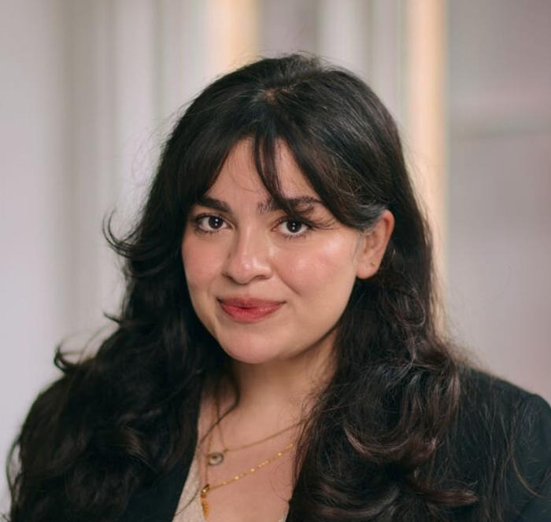
NEW STUDENT REPS IN COUNCIL
Tegan Hadisi
Oxford University
3 Years (2026-2029)
Roxanne Tiemann
University of Bath
1 Year (2026-2027)
Scan the QR Code to register

Slide 10

Scan the QR Code to register

Slide 11
